Slide 1

Task 3: LumiCharge UK Launch: Power the Day with Solar Innovation
Student Name:
Student ID:

Slide 2

Introduction & Target Audience
Targets UK mobile users: youth, commuters, outdoor users, tourists, eco-residents.
Positioned as a premium clean-energy device using STP principles.
Hofstede: high Power Distance → credible, premium branding.
Collectivist culture → group, family and outdoor imagery.
Notes:
Lumicharge, the smart solar-powered charging pod that we are launching under our campaign, targets users of mobile devices in the UK. The campaign will specifically target the five core segments, such as the young tech users, commuters, outdoor lifestyle users, tourists and sustainability-conscious residents. Based on the STP segmentation principles, we position Lumicharge as a high-end, clean-energy attribute that embraces contemporary living in the UK (Sharp, Dawes and Victory, 2024). The cultural dimensions created by Hofstede help us to communicate: since Power Distance is high, it will optimise premium, credible branding, whereas since people are collectivist, imagery of groups, families, and shared outdoor activities will be encouraged. This guarantees a culturally and socio-emotionally appealing campaign.

Slide 3

Creative Concept & Tagline
Concept focuses on UK sunlight as power and possibility.
Main slogan: “Power the Day.”
Tagline: “Charge with the Sun. Live without limits.”
Visuals mix UK city + desert with gold/white palette.
Stands out through cultural relevance and originality.

Slide 4
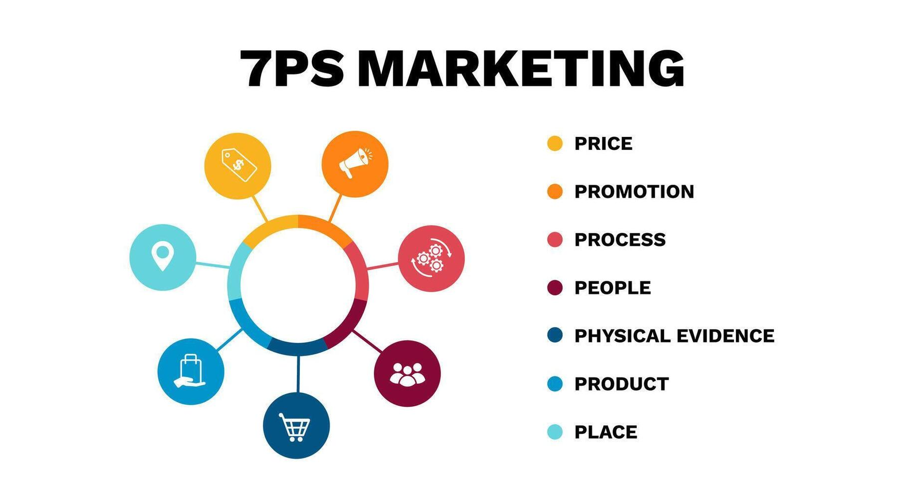
7Ps Marketing Mix
Product: Solar, heat-resistant, AI-optimised pod.
Price: Mid-premium for UK expectations.
Place: Sharaf DG, Virgin, Carrefour, airports, Amazon AE, Noon.
Promotion: Influencers, TikTok/IG ads, billboards, 30s video.
People: Trained in-store brand ambassadors.
Process: Fast delivery, easy warranty, English support.
Physical Evidence: Premium packaging + sustainability labels.
Notes:
Our campaign combines the 7Ps in order to satisfy the marketing theory requirements.
Product: A solar charging pod that is enduring and heat-resistant and is equipped with AI energy optimisation.
Pricing: The price will be mid-premium as they need to capture quality and meet the UK consumer expectations.
Place: Retail distribution via Sharaf DG, Virgin Megastore, Carrefour, UK Airport stores, and Amazon AE and Noon.
Promotion: Influencer partnerships, TikTok ads, Instagram reels, outdoor digital billboards, and a 30-second advertising video showing real-life usage.
People: Trained brand ambassadors of the UK in the stores to demonstrate features (Ghabban, 2025).
Process: Quick delivery, simplified warranty, support in the English language.
Physical Evidence: The symbols of premium packaging and sustainability certifications.
This consistent combination provides strategic transparency and a manner of positioning in the market.

Slide 5
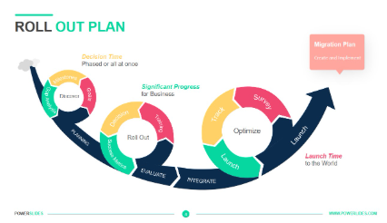
Campaign Roll-Out Strategy
Phase 1: Teasers + influencer unboxings.
Phase 2: UK Marina launch + AIDA-based engagement.
Phase 3: In-store push + airport visibility.
Phase 4: Loyalty rewards + UGC challenges.
Multi-channel rollout ensures full consumer journey coverage.
Notes:
Our roll-out is phase-based.
Phase 1 – Awareness: Teaser posts on social media, influencer unboxings, posts about the sun and countdown posts.
Phase 2 - Engagement: Launch event in UK Marina consisting of live demonstrations, and then a specific advertising campaign with the help of the AIDA model to get consumers to act after attention (Btelligent, 2025).
Phase 3 -Conversion: In-store marketing, package deals and tourist airport visibility.
Phase 4 - Retention: Loyalty reward, user-generated content challenges, and sales services.
This multi-channel approach will reach its goals by maximising the touchpoints, riding on the digital behaviour of the UK, and providing a customer experience throughout the buying process, as well as discovery.

Slide 6

Sample Advertisement & Key Insights
Fast UK scenes: commute, beach, desert, cafés.
Lumicharge shown powering devices in every moment.
Voiceover: “Keep going, whatever you have planned.”
Strong cultural fit, theory-driven, and builds UK brand credibility.
Notes:
The advert sample includes hasty lifestyle clips in UK: commute, beach, desert camping, and crowded cafes. In every scene, Lumicharge is seen to take full control of powering devices using sunlight power. The voice of one working with an English accent says: Keep going, whatever you have planned from day to day (Prabhu TL, 2019).
The last learning is that the campaign is a positive indicator of cultural adaptation, theory and imagination. This campaign has been innovative and strategic in its communication, thus qualifying as an excellent performance by being integrated with Hofstede, AIDA and the 7Ps. Lumicharge will be the most reputable clean energy portable charging device in the UK.

